Slide 1
INTRODUCTION TO INNOVATION, IP MANAGEMENT & ENTREPRENEURSHIP
MGT-207
Dr. SHOBHANA.N
Faculty,
School of Management,
SASTRA Deemed to be University,
shobhana@mba.sastra.edu

Slide 2
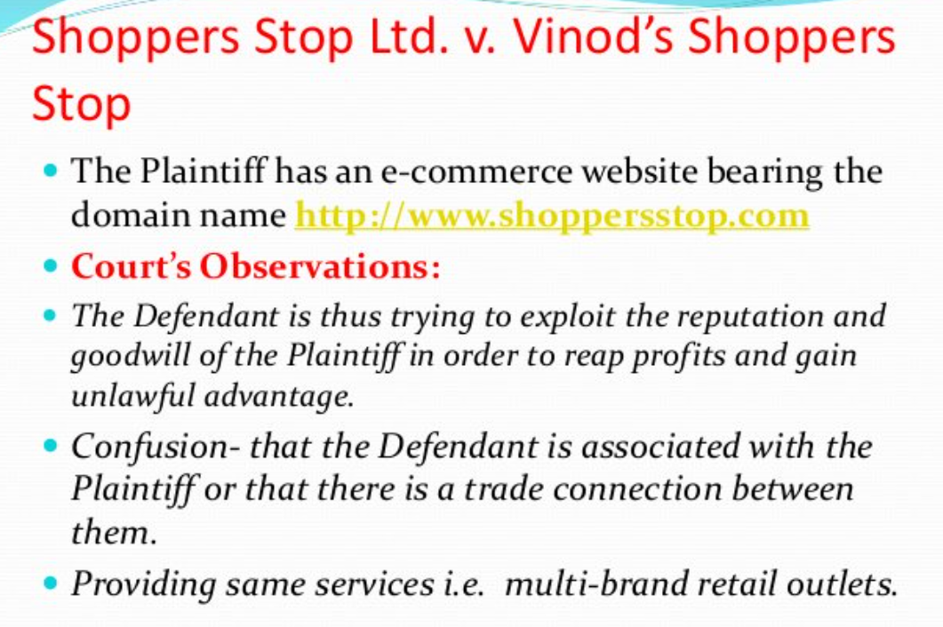

Slide 3
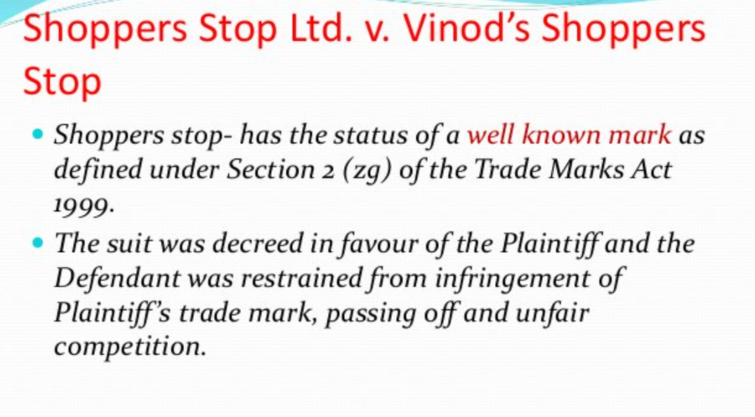

Slide 4
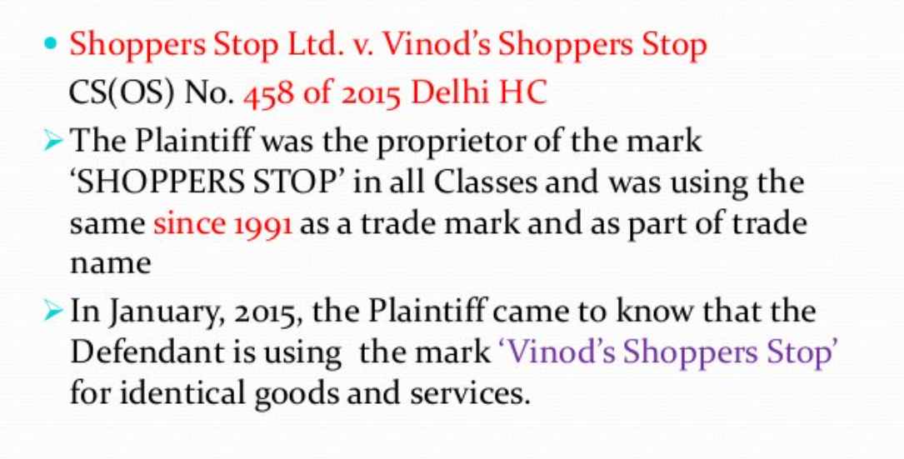

Slide 6
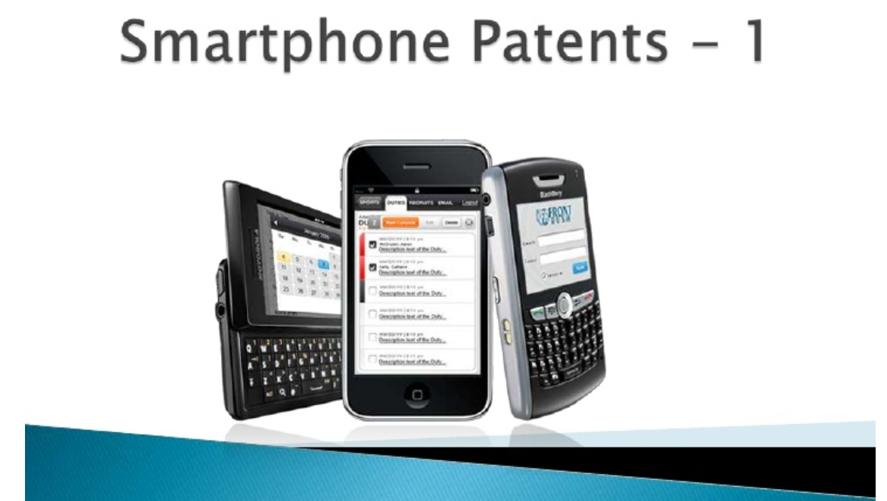

Slide 7
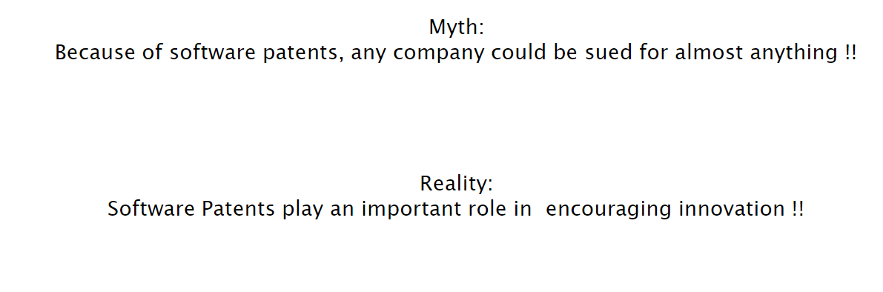

Slide 8
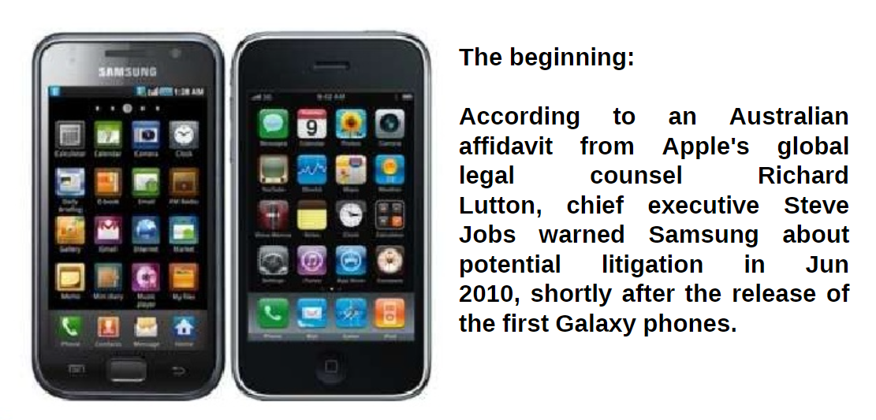

Slide 9
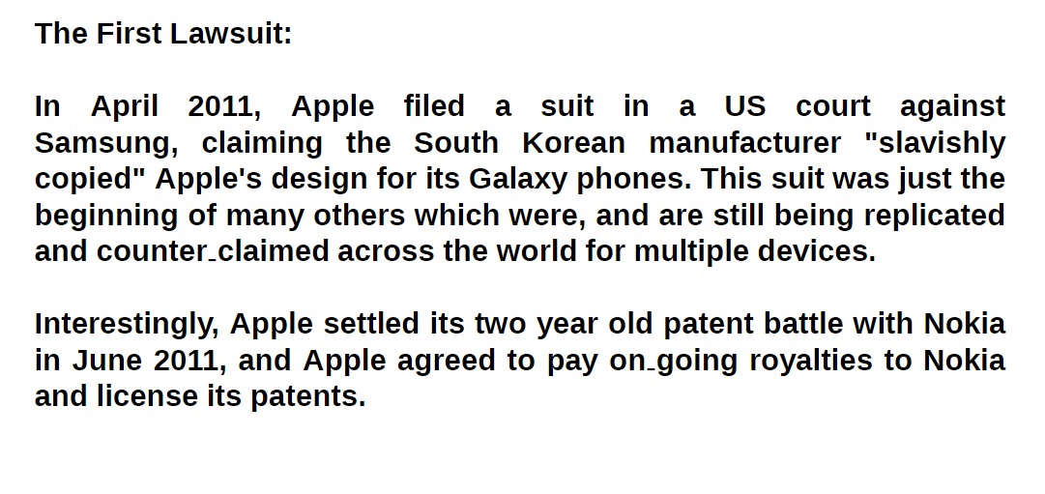

Slide 10
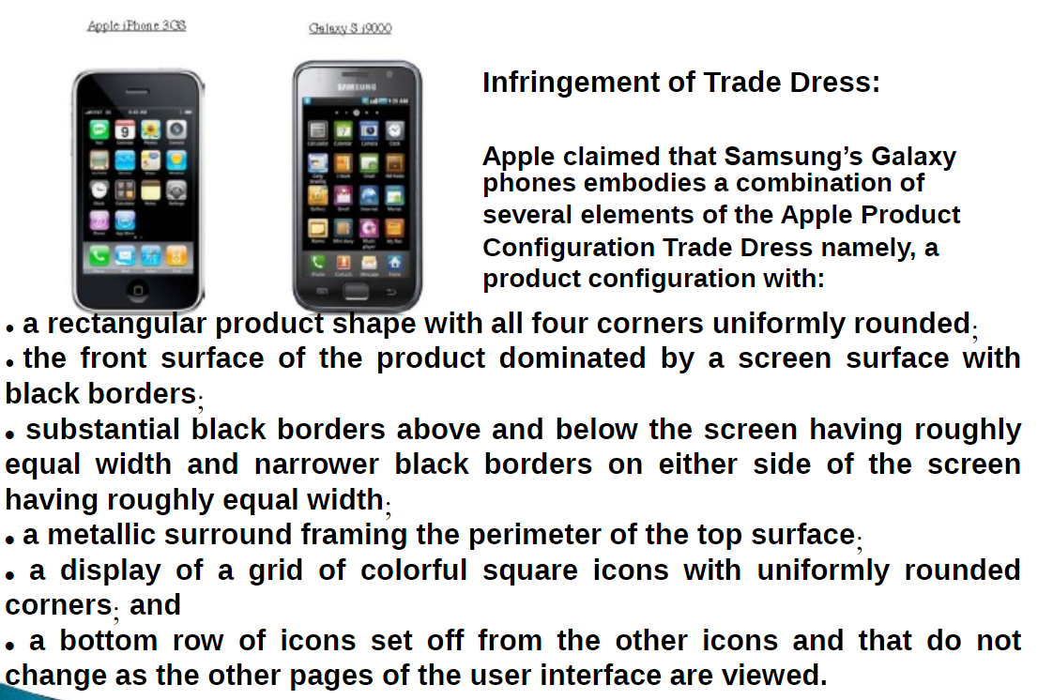


Slide 11
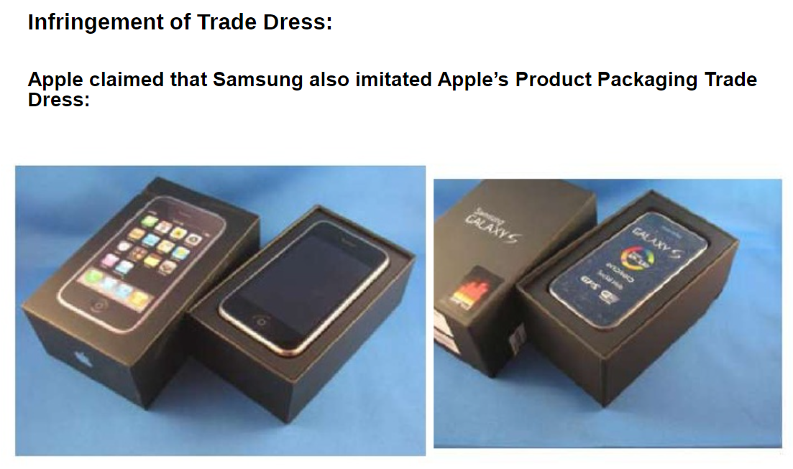

Slide 12
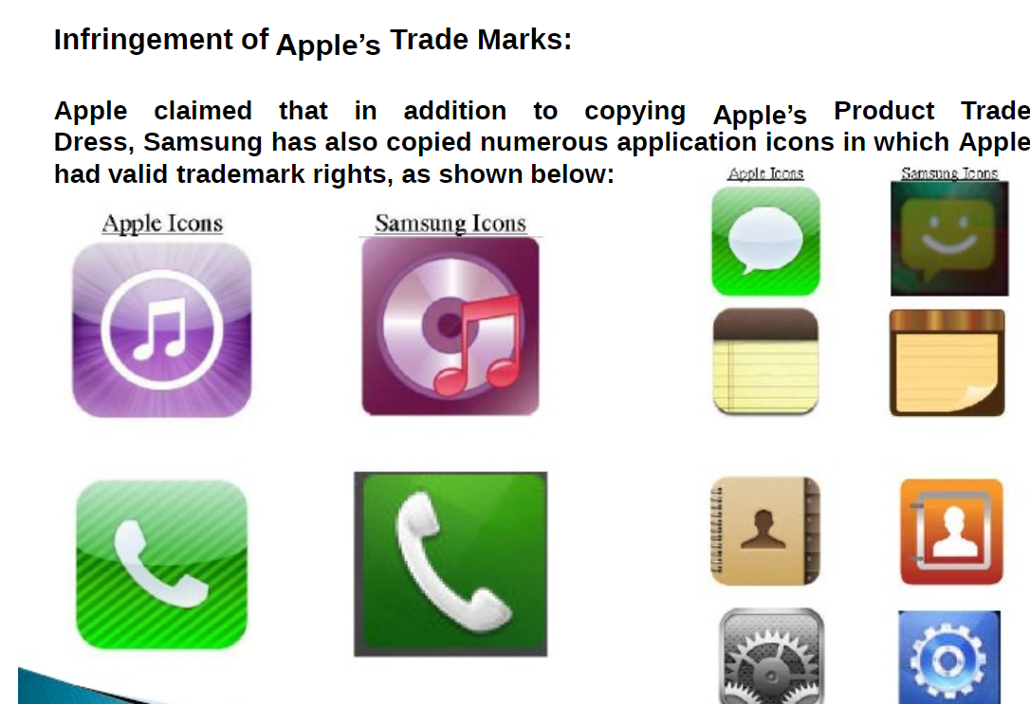

Slide 13
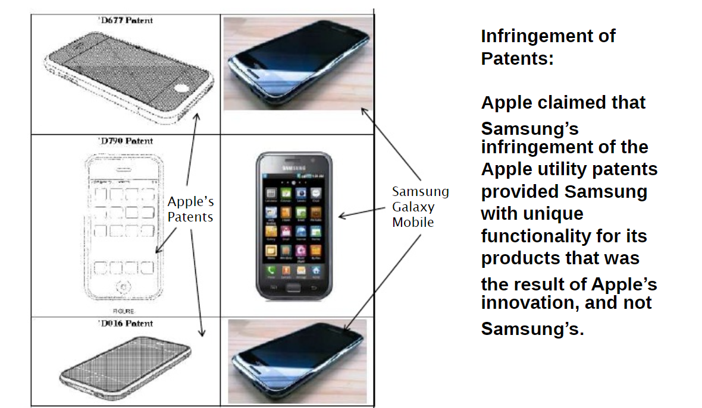

Slide 14
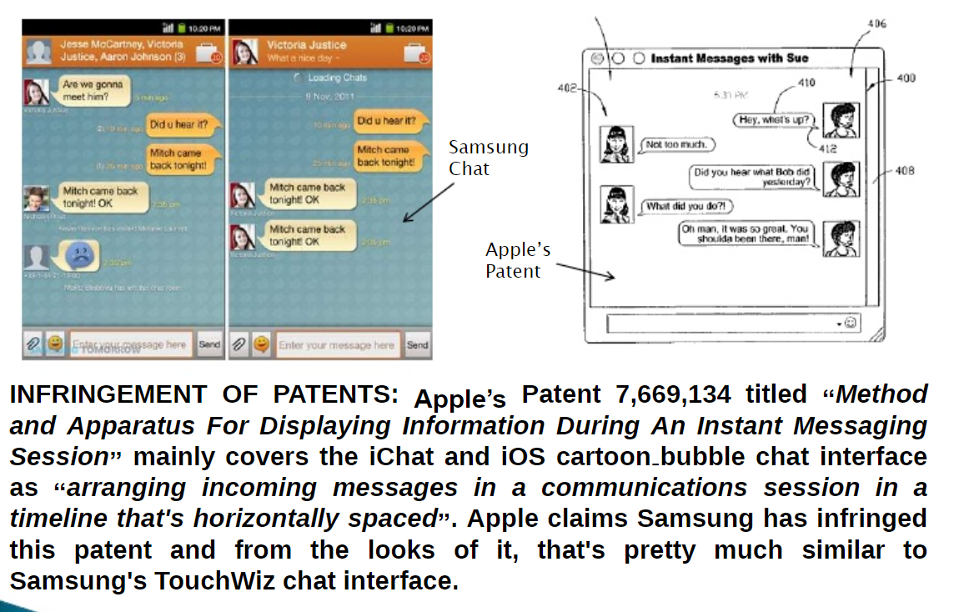

Slide 15
There were seven patents at issue in the latest case -- five held by Apple and two by Samsung. Apple accused Samsung of infringing US patents Nos. 5,946,647; 6,847,959; 7,761,414; 8,046,721; and 8,074,172. All relate to software features, such as quick links for '647, universal search for '959, background syncing for '414, slide-to-unlock for '721, and automatic word correction for '172. Overall, Apple argued that the patents enable ease of use and make a user interface more engaging.
Samsung, meanwhile, had accused Apple of infringing US patents Nos. 6,226,449 and 5,579,239. The '449 patent, which Samsung purchased from Hitachi, involves camera and folder organization functionality. The '239 patent, which Samsung also acquired, covers video transmission functionality, and the Korean company accused Apple's FaceTime of infringing the technology.

Slide 16
Who won?
That's tricky. Both companies were found guilty of infringing some of each other's patents and ordered to pay damages. Ultimately, it wasn't a clear-cut win for either company, but the verdict also wasn't the overwhelming defeat Samsung faced in 2012. By awarding Apple less than 10 percent of the damages it wanted, the jury of mostly tech novices, which deliberated for three full days after a four-week trial, sent a much different message than the prior trial that netted Apple nearly $1 billion. Samsung surely feels relieved by the outcome, though it still was deemed a copycat in some respects. And Apple, which was vindicated in some of its accusations, probably believes Samsung's punishment is too light.

Slide 17
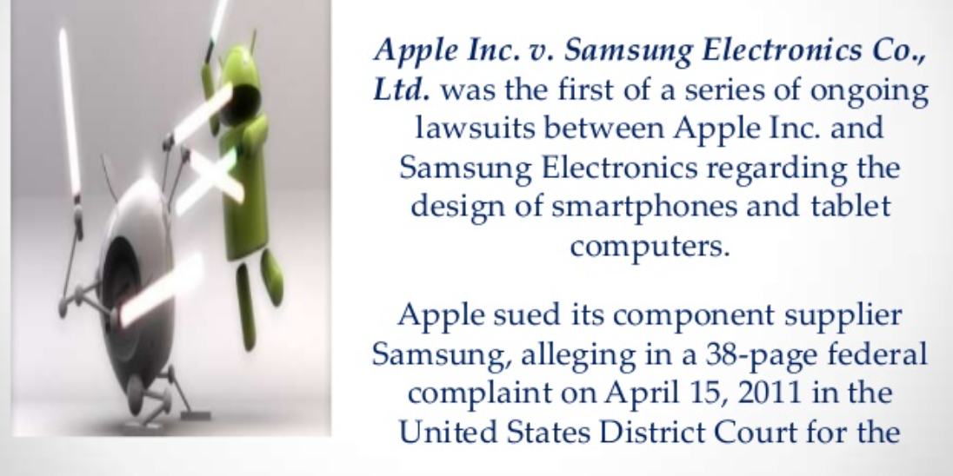

Slide 18
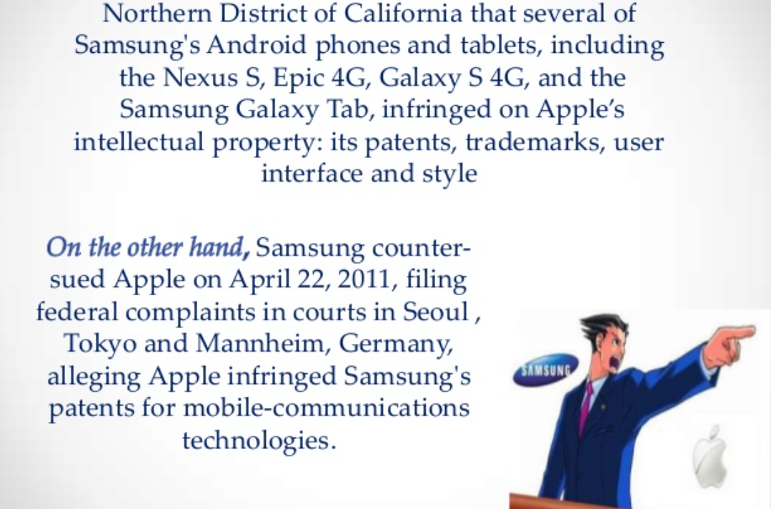

Slide 19
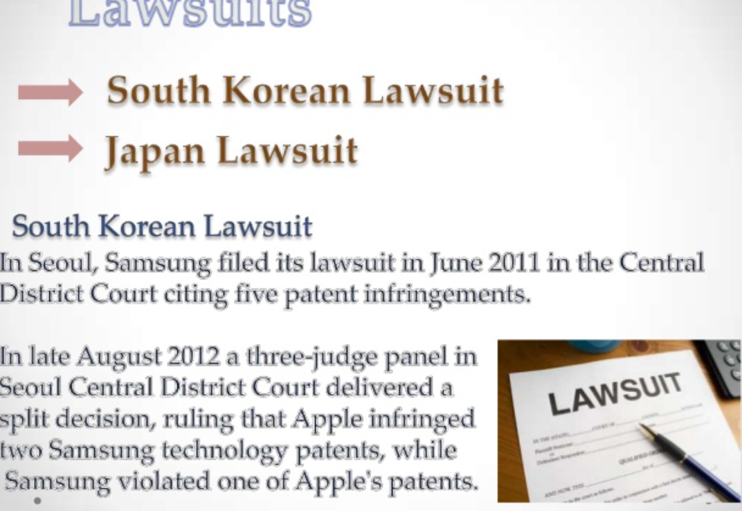

Slide 20
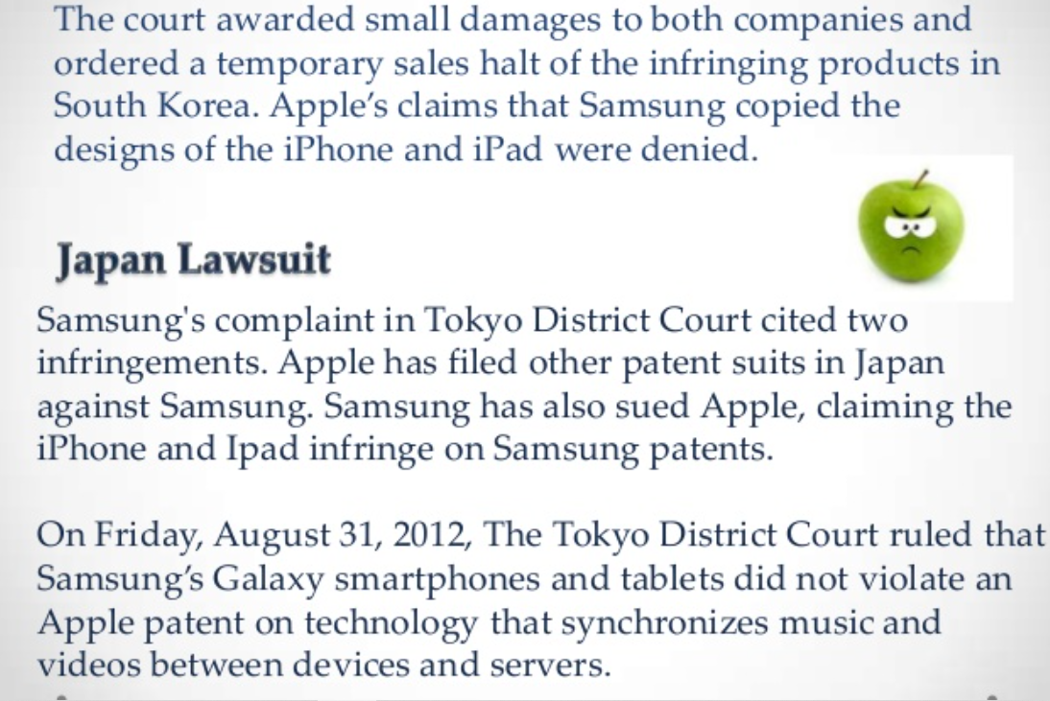

Slide 21
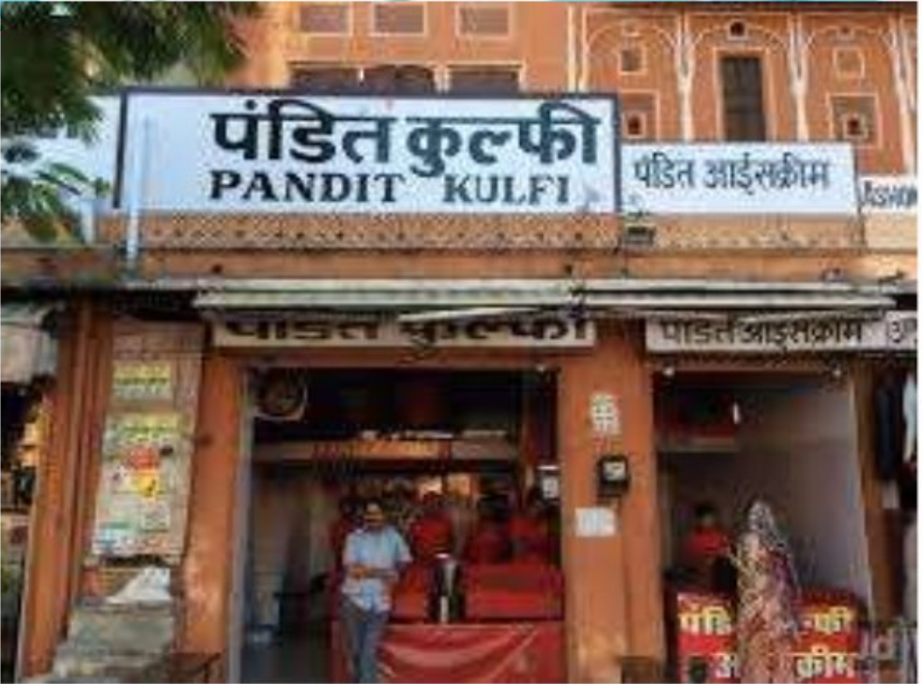

Slide 22
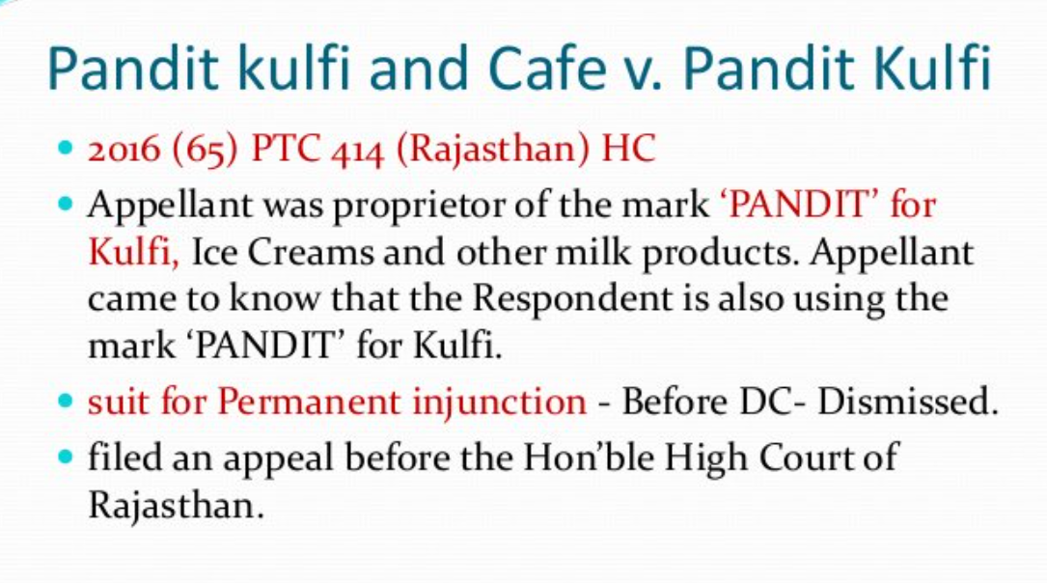

Slide 23
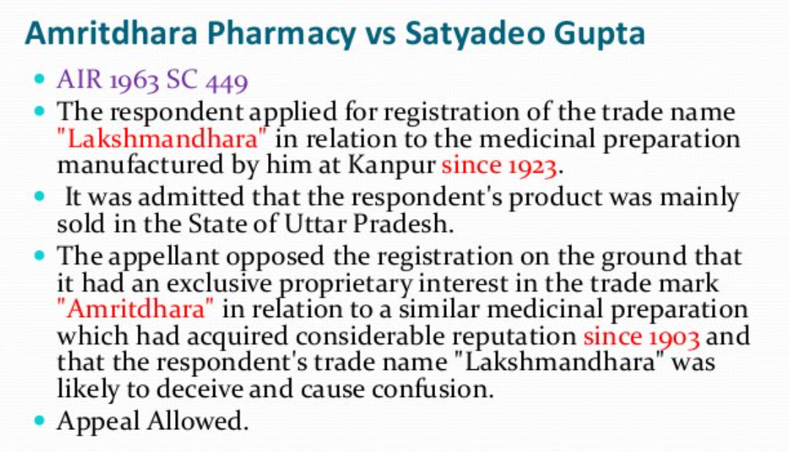

Slide 25
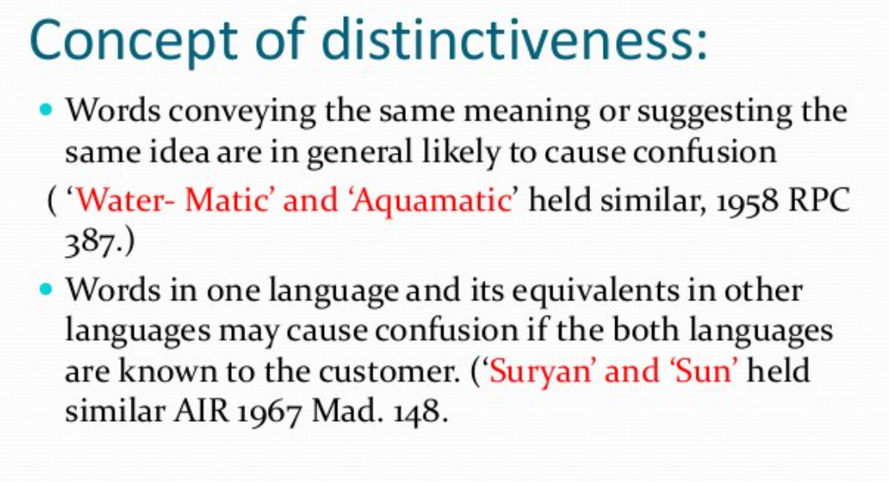

Slide 26
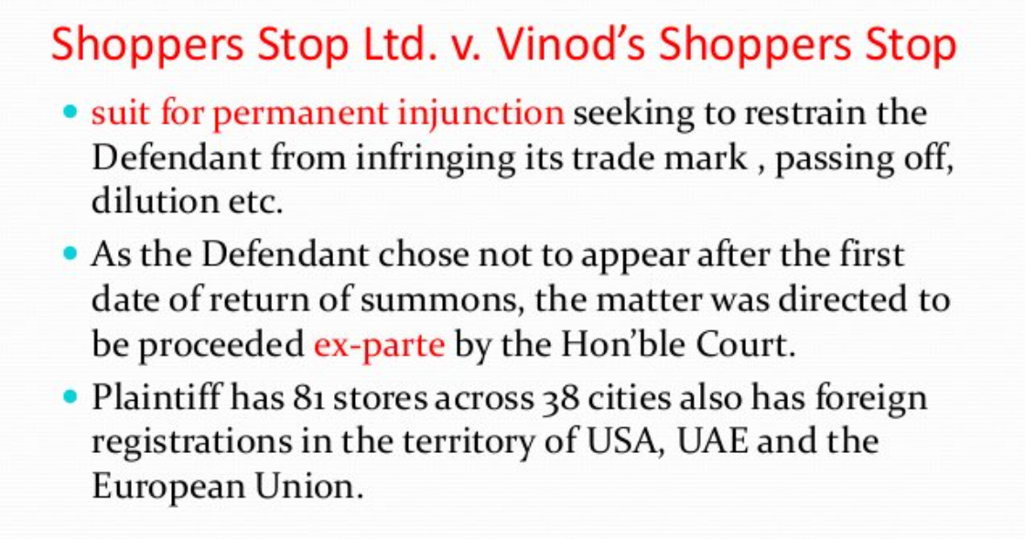

Slide 31
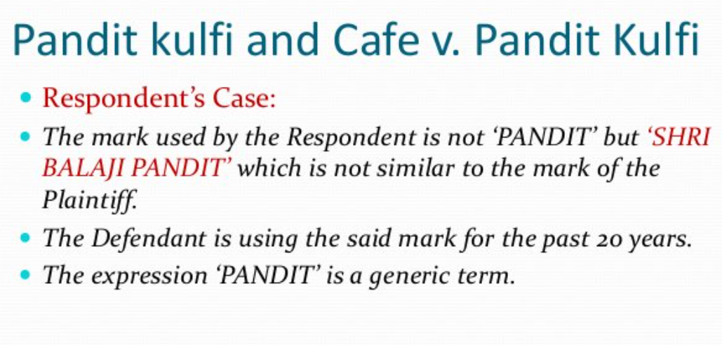

Slide 32
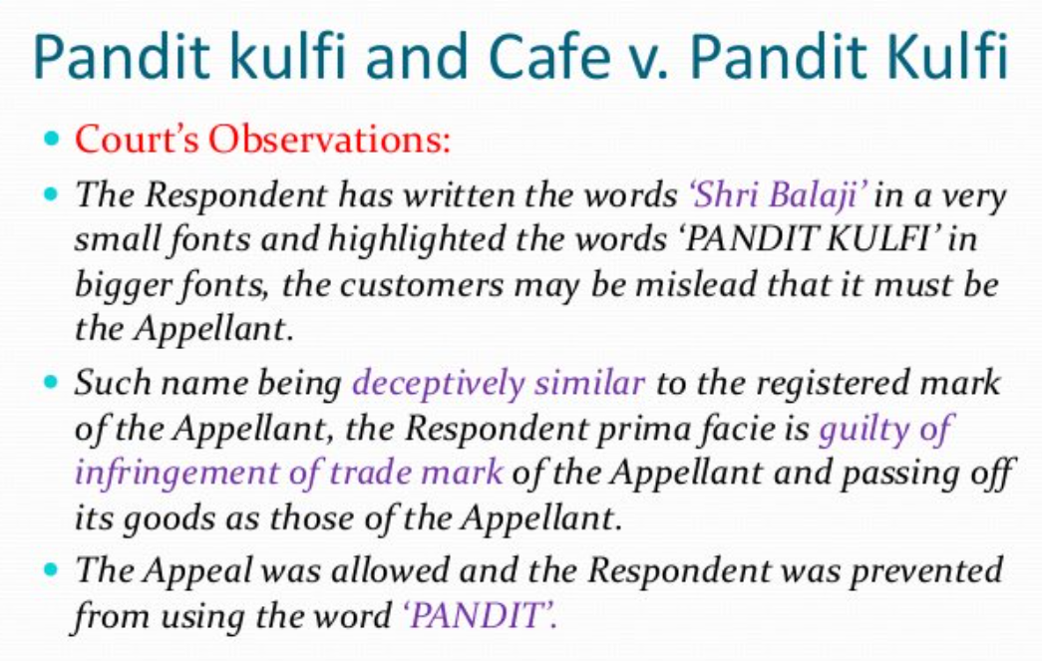

Slide 33
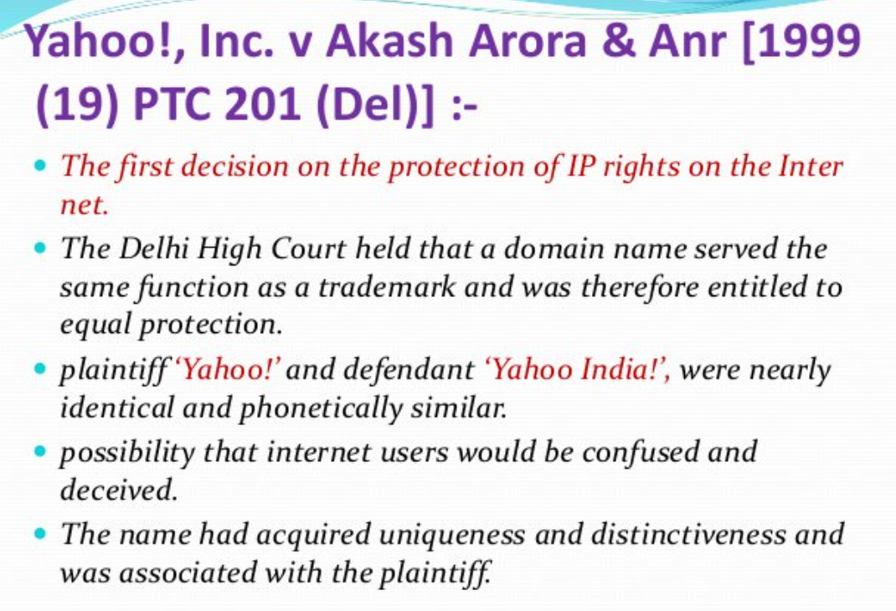

Slide 34
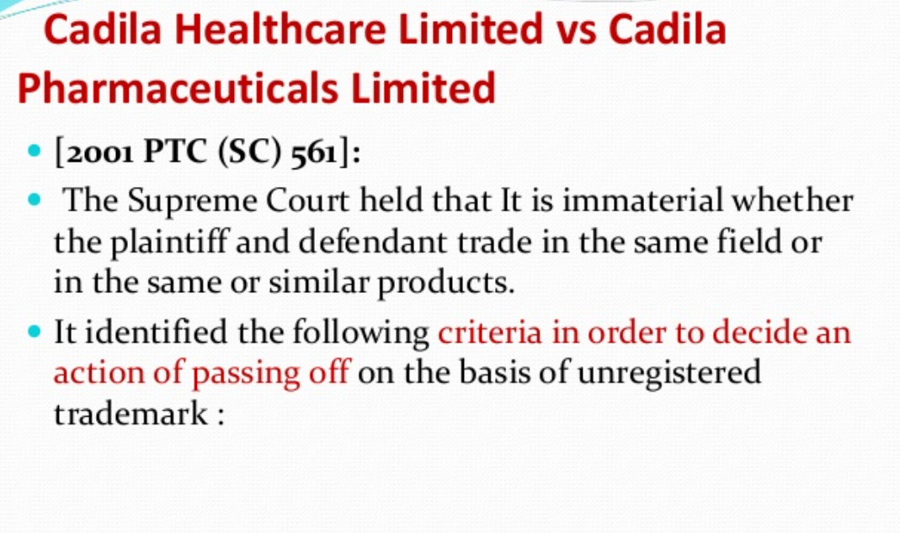

Slide 35
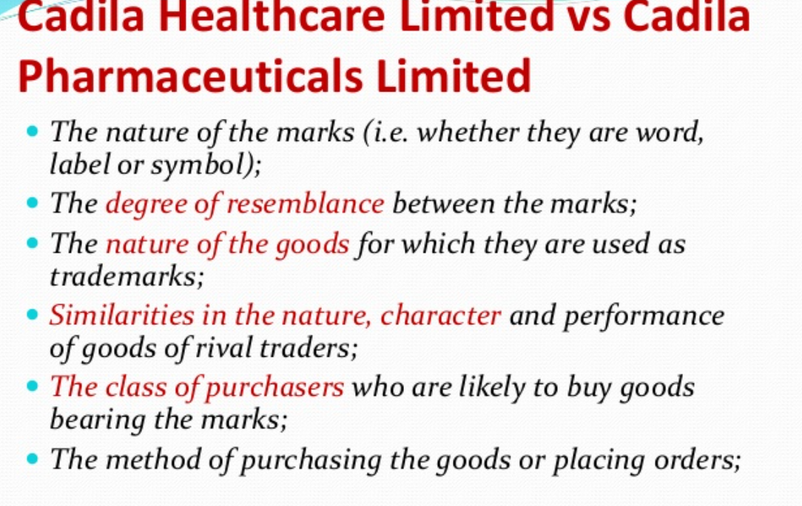

Slide 36
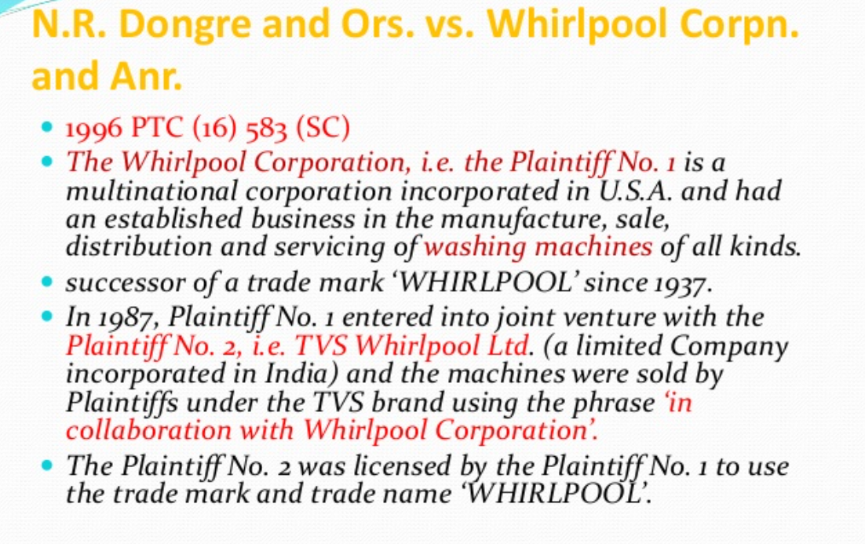

Slide 37
